Slide 1



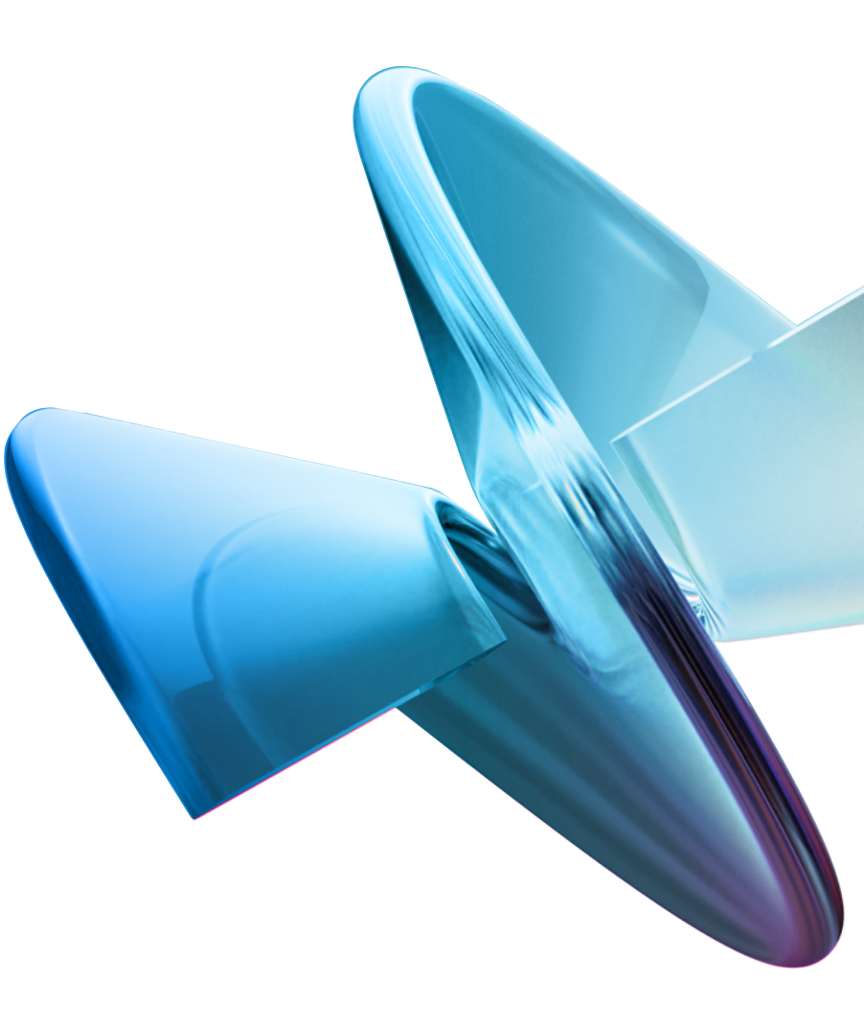
Smt. Kamala and Sri Venkappa M. Agadi College of Engineering & Technology Lakshmeshwar - 582116
Information Science and Engineering
“HealthWings: Smart Navigation and Gesture-Controlled
Medical Drones”
Presented by : Tejas Shettar, Prajwal K S, Chiranjeevi Hemanth S T, Amarappa I
GUIDE : Mrs. Prathima Mahapurush

Slide 2


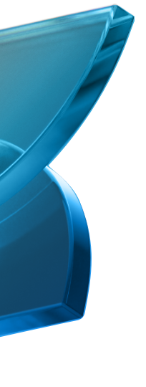


CONTENTS
Introduction
Problem Statement
Objectives
Proposed System
System Design & Architecture
Algorithms Used
Experimental Results & Discussion
Conclusion & Future Work
References

Slide 3
INTRODUCTION
The healthcare sector faces challenges in emergency logistics.
Drones can improve medical supply delivery.
HealthWings integrates AI and gesture control for smart navigation.
This presentation explores the feasibility and applications.

Slide 4
Problem Statement
Current medical response systems face delays and accessibility issues. Remote areas lack timely access to critical supplies. Existing drone solutions have limited navigation and control. HealthWings addresses these challenges. It offers a faster, smarter solution.

Slide 5



OBJECTIVES
Our main goal is to create a reliable, efficient medical drone system. We aim to improve navigation accuracy and simplify user control. It's crucial to reduce response times. This will provide better medical support. We want to transform emergency care.
01
Enhanced Navigation- Accurate AI routing.
0
02
Intuitive Control- Simple gesture interface.
03
Reduced Response- Quick medical support.

Slide 6





Proposed System :
1. AI-powered smart navigation.
AI-Based Route Optimization – Uses real-time data and AI algorithms to optimize flight paths, ensuring fast and efficient medical supply delivery.
2. Real-Time Obstacle Avoidance – Equipped with sensors and AI-driven path correction to detect and avoid obstacles for safe and precise navigation.
3. AI-Powered Gesture Recognition – Uses Convolutional Neural Networks (CNNs) to interpret hand gestures, enabling intuitive and contactless drone control.

Slide 7
System Design & Architecture
Navigation module: AI-based path optimization.
Gesture control: CNN for hand gesture recognition.
Communication: 5G & Wi-Fi for real-time data exchange.
Drone frame: Carbon Fiber, 1.5kg payload.

Slide 8
Algorithms Used
Smart Navigation: A* and RRT pathfinding algorithms.
Gesture Recognition: CNN-LSTM hybrid model.
Emergency Response: AI-based triage and route optimization.
Obstacle Avoidance: YOLOv5 object detection.

Slide 9
Experimental Results & Discussion
AI-powered navigation achieved 92% accuracy.
Gesture recognition success rate: 95%.
60% reduction in medical supply delivery time.
Improved coordination with emergency teams.

Slide 10
Conclusion & Future Work
HealthWings improves emergency medical logistics.
Future work includes improved AI decision-making.
Enhancing battery life for extended flight time.
Integration of IoT-based patient health monitoring.

Slide 11
References
1. "Implementation of IoT and UAV Based WBAN for Healthcare Applications" Authors: M. A. Kassab, M. A. Ismail, and M. A. Elhosseini Published in: 2021 IEEE .
2"Motion Estimation and Hand Gesture Recognition-Based Human UAV Interaction" Authors: S. Lee, J. Kim, and K. Park Published in: IEEE Access, 2022.

Slide 12



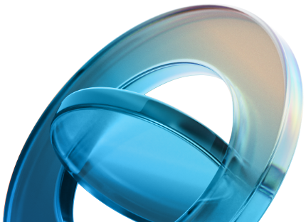
THANK YOU

